Slide 1
1) A study on blood types in a population found the following genotypic distribution among the people sampled: 1101 were MM, 1496 were MN and 503 were NN. Calculate the allele frequencies of M and N, the expected numbers of the three genotypic classes (assuming random mating). Using X2, determine whether or not this population is in Hardy-Weinberg equilibrium.

Slide 2
GENOTYPE FREQUENCIES:
MM (p2) = 1101/3100 = 0.356
MN (2pq) = 1496/3100 = 0.482
NN (q2) = 503/3100 = 0.162
ALLELE FREQUENCIES:
Freq of M = p = p2 + 1/2 (2pq) = 0.356 + 1/2 (0.482) = 0.356 + 0.241 = 0.597
Freq of N = q = 1-p = 1 - 0.597 = 0.403.
EXPECTED GENOTYPE FREQUENCIES (assuming Hardy-Weinberg):
MM (p2) = (0.597)2 = 0.357
MN (2pq) = 2 (0.597)(0.403) = 0.481
NN (q2) = (0.403)2 = 0.162
EXPECTED NUMBER OF INDIVIDUALS of EACH GENOTYPE:
# MM = 0.357 X 3100 = 1107
# MN = 0.481 X 3100 = 1491
# NN = 0.162 X 3100 =502
CHI - SQUARE (X2):
X2 = Σ(O - E)2 / E
X2 = (1101-1107)2 /1107 + (1496-1491)2 /1491 + (502-503)2 /503
= (-6)2 /1107 + (5)2 /1491 + (-1)2 /503
= 0.0325 + 0.0168 + 0.002
= 0.0513
X2 (calculated) < X2 (table) [3.841, 1 df, 0.05 ls].
Therefore, conclude that there is no statistically significant difference between what you observed and what you expected under Hardy-Weinberg. That is, you fail to reject the null hypothesis and conclude that the population is in HWE.

Slide 3
A scientist has studied the amount of polymorphism in the alleles controlling the enzyme Lactate Dehydrogenase (LDH) in a species of minnow. From one population, 1000 individuals were sampled. The scientist found the following fequencies of genotypes: AA = .080, Aa = .280; aa = .640. From these data calculate the allele frequencies of the "A" and "a" alleles in this population. Use the appropriate statistical test to help you decide whether or not this population was in Hardy-Weinberg equilibrium.

Slide 4
Genotype frequencies:
Freq AA = p2 = 0.08
Freq Aa = 2pq = 0.28
Freq aa =q2 = 0.64
Allele frequencies:
p = Freq A = 0.08 + 1/2 (0.28) = 0.08 + 0.14 = 0.22
q = Freq a = 1 - 0.22 = 0.78
IF population is in HWE, then you'd expect the following frequencies:
p2 = (0.22)2 = 0.0484
2pq = 2(0.22)(0.78) = 0.3432
q2 = (0.78)2 = 0.6084
Genotype
Expected Numbers/Observed Numbers
AA
0.0484 X 1000 = 48.4
0.080 X 1000 = 80
Aa
0.3432 X 1000 = 343.2
0.280 X 1000 = 280
aa
0.6084 X 1000 = 608.4
0.640 X 1000 = 640
X2 = [(80 - 48.4)2/ 48.4] + [(280 - 343.2)2 / 343.2] + [(640 - 608.4)2/ 608.4]
= 20.63 +11.64+1.64
= 33.91
X2 (Calculated) > X2 (table), therefore reject null hypothesis. Not in HWE.

Slide 5
The compound phenylthiocarbamide(PTC)tastes very bitter to most persons. The inability to taste PTC is controlled by a single recessive gene. In the American white population, about 70% can taste PTC while 30% cannot (are non-tasters). Estimate the frequencies of the Taster (T) and nontaster (t) alleles in this population as well as the frequencies of the diploid genotypes.

Slide 6
Estimated Freq t = q =square root of q2=square root of 0.30 = 0.5477
Freq T = p = 1 - q = 1 - 0.5477 = 0.4523
Expect under HWE:
TT = p2 = (0.4523)2 = 0.2045
Tt = 2pq = 2(0.4523)(0.5477) = 0.4956
tt = q2 = (0.5477)2 = 0.2999

Slide 7
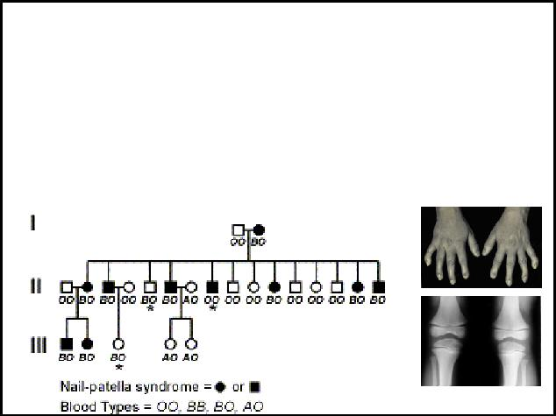
Mapping Human Genes
Here is a pedigree that shows blood types and “nail patella syndome”
– NPS is a rare genetic disease occurring in only about 2/100,000 births, characterized by underdeveloped nails and kneecaps.
NPS is a dominant trait

Slide 8
Lod scores
Test to compare the likelihood that two loci are linked, vs the likelihood that the two loci are unlinked.
LOD = log₁₀ likelihood if linked
likelihood if the loci are unlinked
LOD = “logarithm of the odds”

Slide 9
Testcross BN/bn x bn/bn
Genotype | Expected | Expected
 | if unlinked | if “r” cM apart
BN/bn | 0.25 | (1-r)/2
Bn/bn | 0.25 | r/2
bN/bn | 0.25 | r/2
bn/bn | 0.25 | (1-r)/2
Prob(recombination) = r |  | Prob (no recombination) = 1-r
Split that among two recombinant classes |  | Split that among two parental classes

Slide 10
Lod score calculation
Assume you have a testcross family with 8 non-recombinant offspring
and zero recombinants between genes B and N
Then, start with a hypothesis about linkage:
– maybe they are 10 cM apart
What is the probability of no recombinantion for each gamete?
1-r = prob(no recombination) = 0.90
Remember there are two different parental genotypes.
If you keep track of individual genotypes, then each has probability (1-r)/2 so, (1-r)/2 = 0.45
Probability of 8 non-recombinants if genes are linked (at 10 cM) is: 0.45⁸
Lod score = log₁₀ (0.45⁸/0.25⁸)
  log₁₀ (110.19) = 2.04 (LOD must be >3.0 to be “significant”)
Lod score calculation
Assume you have a testcross family with 8 non-recombinant offspring and
zero recombinants between genes B and N
Then, start with a hypothesis about linkage:
– maybe they are 10 cM apart
What is the probability of no recombination for each gamete?
1-r = prob(no recombination) = 0.90
Remember there are two different parental genotypes.
If you keep track of individual genotypes, then each has probability (1-r)/2 so, (1-r)/2 = 0.45
Probability of 8 non-recombinants if genes are linked (at 10 cM) is: 0.45⁸
Lod score = log₁₀ (0.45⁸/0.25⁸)
  log₁₀ (110.19) = 2.04 (LOD must be >3.0 to be “significant”)
• Probability if not linked is 0.25⁸ | The pattern of 8 non-recombinants is 110
remember, r=0.5 when loci are not linked | times more likely if the genes are linked at 10
 | cM than if they were unlinked

Slide 11
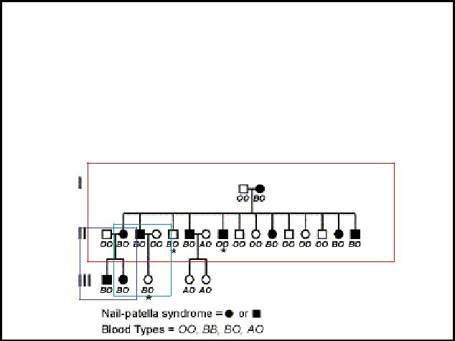
Human pedigree mapping
Determine genotypes in the pedigree
Find informative families (e.g. test crosses)
What fraction of offspring are recombinant?

Slide 12
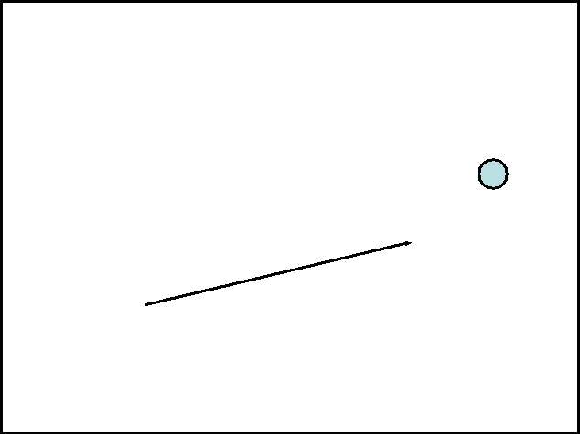
Calculate LOD score
• Fam 1 : | 2/13 recombinant |  |  |  |  |  |  |  |  |  | B/O N/n
• Fam 2: | 0/2 |  | OO |  |  |  |  |  |  |  |  |  |  | BO
• Fam 3 | 1/1 | B/O N/n
 |  |  |  |  |  | BO |  |  |  |  |  | BO
 |  | Both offspring are non-recombinant
Prob (seeing this non-recombinant genotype)
= (1-r)2
If r=0.5, then Prob = 0.25 |  |  | Log Odds Ratio =
If r=0.1, then Prob = 0.45 |  |  | Log (L(r=x) / L(r=0.5))

Slide 13
 | • Fam 1 : |  | 2/13 recombinant
 | • Fam 2: |  | 0/2 |  | OO |  |  |  |  |  |  |  |  |  | BO
 | • Fam 3 |  | 1/1
Family 2 |  |  |  |  |  | BO |  |  |  |  | BO
Likelihood if independent? |  |  |  | 0.25*0.25 |  | =0.0625
Likelihood if linked at r=0.1? |  |  |  | 0.45*0.45 |  | =0.2025
Ratio = 3.24
LOD = 0.51 |  |  |  |  |  | Log Odds Ratio =
 |  |  |  |  |  | Log (L(r=x) / L(r=0.5))

Slide 14
Calculate LOD score
• Fam 1 : 2/13 recombinant
• Fam 2: | 0/2
• Fam 3 | 1/1
Family 1
Likelihood if independent? |  | 0.25¹¹ * 0.25² |  | =1.49 x10⁻⁸
Likelihood if linked at r=0.1? |  | 0.45¹¹ * 0.05² |  | =3.83 x10⁻⁷
Ratio = 25.7
LOD = 1.41
. 05*.05 ^{2 recombinants}
.45*.45*.45*.45* . . . *.45 _{11 non-recombinants}

Slide 15
Calculate LOD score
• Fam 1 : | 2/13 recombinant
• Fam 2: | 0/2
• Fam 3 | 1/1
Family 3
Likelihood if independent? |  | 0.25 | =0.25
Likelihood if linked at r=0.1? |  | 0.05 | =0.05
Ratio = 0.20
LOD = -0.69
1 recombinant

Slide 16
Calculate LOD score
Add the LOD scores from all 3 families:
1.41 + 0.51 + -0.69 = 1.22
• Fam 1: | 2/13 | LOD = 1.41
• Fam 2: | 0/2 | LOD = 0.51
• Fam 3 | 1/1 | LOD = -0.69
Should be bigger than 3.0 for significant linkage
Now, do that whole exercise for other values of r!

Slide 17
Calculate LOD score
R LOD
0.1 -1.24
0.1 1.22
0.2 1.46
0.3 1.23
0.4 0.73
0.5 0
LOD is maximum around r=0.2, so that is the best estimate of linkage

Slide 18
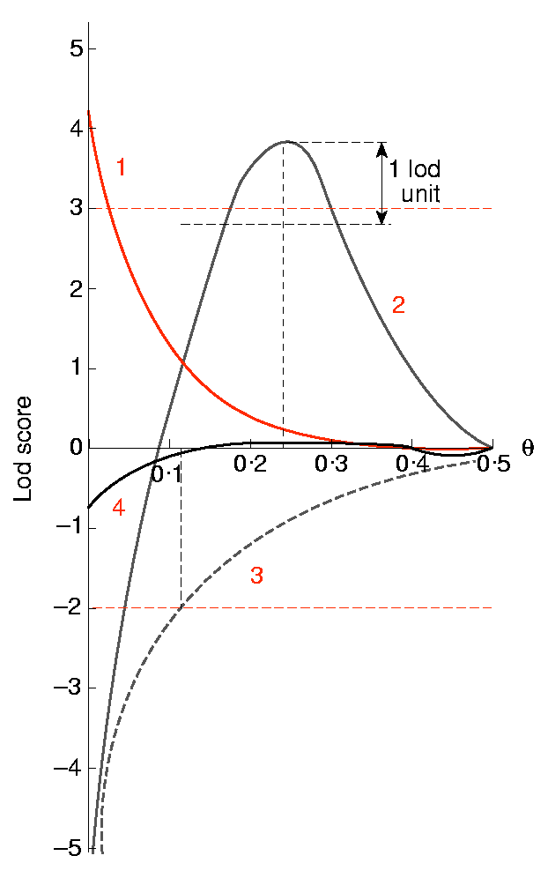
A lod score of 3 or more is considered good evidence for linkage.
A lod score of -2 or less is evidence against linkage.
Values between -2 and 3 are inconclusive and indicate that more data must be obtained.

Slide 19
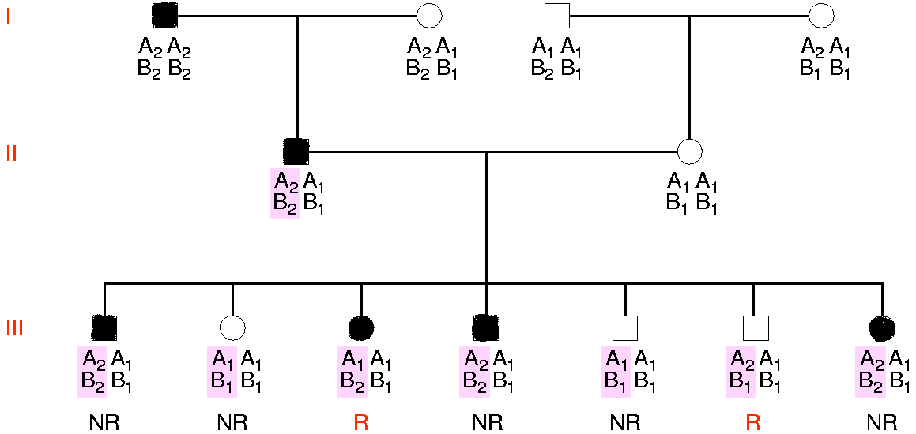

Slide 20
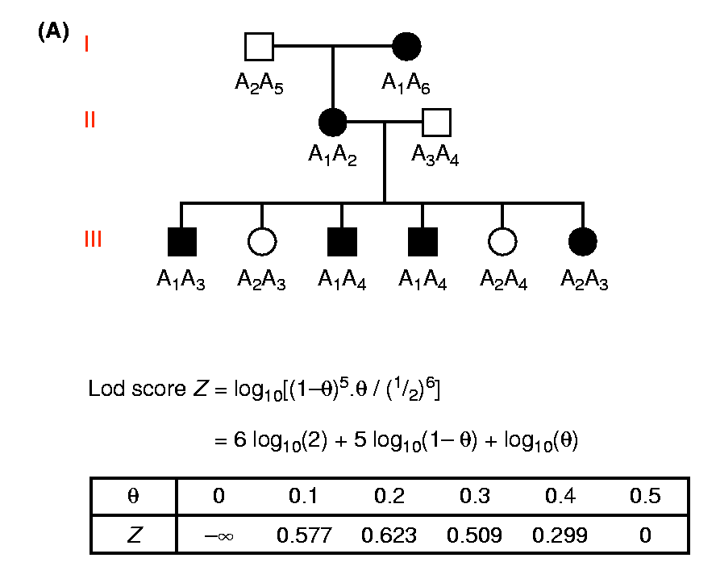

Slide 21
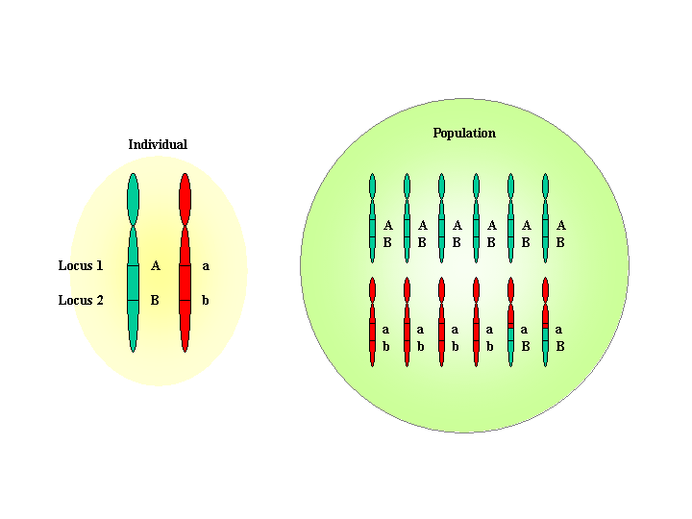
Linkage disequilibrium, LD
Alleles are in LD, if they are inherited together more often than could be expected based on allele frequencies
Two loci are inherited together, because recombination during meiosis (formation of gametes) separates them only seldom

Slide 22
Haplotype
A haplotype is series of genetic variants (e.g., SNP) on one chromosome that are inherited from one parent
In subsequent generations the chromosomal haplotype is broken up by crossing over events in meiosis
In practice, “haplotype” refers to closely linked genetic loci.
SNPs that are located in close proximity tend to travel together → known as linkage disequilibrium (LD)
  In general, loci that are located more closely together on a chromosome will be in stronger LD
  Correlation between LD and physical distance separating two loci is modest
  Some loci that are separated 20 bp will not be in LD, while other loci separated by 200.000 bp will be in tight LD.

Slide 23
Haplotype
Multiple loci in the same chromosome that are inherited together
Usually a string of SNPs that are linked
locus
alleles
haplotypes
(combi of
three alleles
on one
chromosome

Slide 24
Haplotype construction
No good experimental methods available to identify haplotypes
→ Computational methods to create haplotypes from genotype data

Slide 25
...Haplotype construction
Family-based haplotype construction
  Linkage analysis softwares: Simwalk, Merlin, Genehunter, Allegro...
Population-based haplotype construction
  Not as reliable as family-based
  EM-algorithm (expectation maximization algorithm), described in http://www-gene.cimr.cam.ac.uk/clayton/software/
  SnpHap
  PHASE

Slide 26
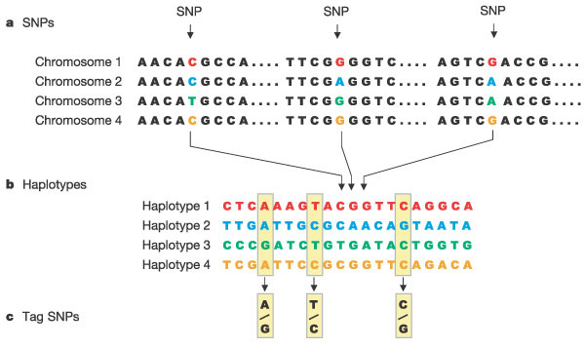
Haplotype blocks
  Low recombination rate in the region
  Strong LD
  Low haplotype diversity
  Small number of SNPs in the block are enough to identify common haplotypes; tag SNPs

Slide 27
Formation of haplotype blocks
Recombination events that shuffle the components of a haplotype do not occur at random
Some locations in the genome have much higher recombination rates
  Recombination hotspots
The occurrence of recombination hotspots has contributed to the limited haplotype diversity of the genome
  There are fewer observed haplotypes than would be expected by chance
Size of haplotype blocks vary from about 9kb to over 100kb. What is the size of a gene?

Slide 28
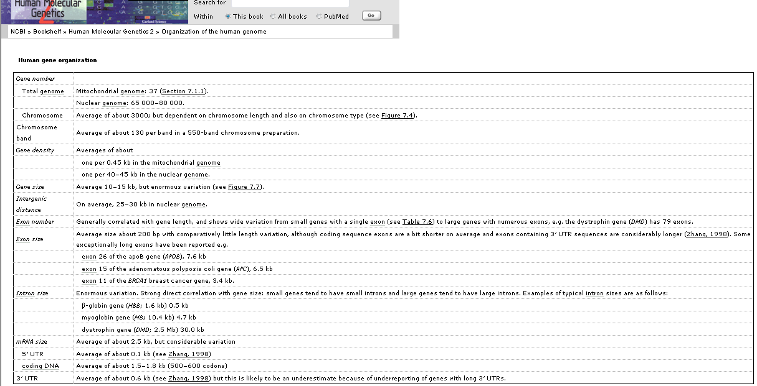
Average gene size: 10-15kb

Slide 29
Formation of haplotype blocks
meiosis
x
1
1
1
2
2
2
2
2
1
1
1
2
chromosomes
recombination

Slide 30
2
2
1
2
3
1
Few generations
Hundreds of generations

Slide 31
1-150 kb
Average block size
  African populations: 11 kb
  Non-african populations: 22 kb
  60%-80% of the genome is in the blocks of > 10 kb

Slide 32
Block frequencies
Typically, only 3-5 common haplotypes account for >90% of the observed haplotypes

Slide 33
Benefits of haplotypes instead of individual SNPs
Information content is higher
Gene function may depend on more than one SNP
Smaller number of required markers
  The amount of wrong positive association is reduced
Replacing of missing genotypes by computational methods
Elimination of genotyping errors
Challenges:
  Haplotypes are difficult to define directly in the lab; computational methods
  Defining of block boarders is ambiguous; several different algorithms

Slide 34
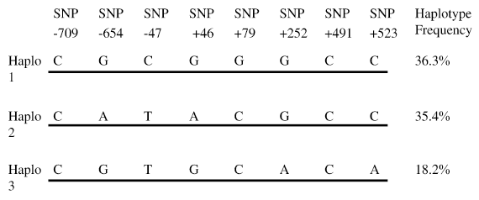
Haplotype example
Example: β₂-adrenergic receptor gene (ADRB2)
Consider 8 SNPs; each two alleles
One would expect 2⁸=256 haplotypes
Observed number of haplotypes is much smaller and only 3 haplotypes are estimated to occur with large frequency

Slide 35
Genotypes and haplotypes
Diploid organism.
2 bi-allelic loci on the same chromosome (e.g., SNPs).
First locus alleles A and T: 3 genotypes AA, AT, and TT.
Second locus alleles G and C: 3 genotypes GG, GC, and CC.
Individual: 9 possible configurations for the genotypes at these two loci.
Punnett square (next slide) shows the possible genotypes that an individual may carry and the corresponding haplotypes.

Slide 36
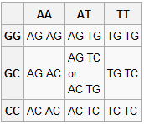
Genotypes and haplotypes
Number of haplotypes grows exponentially
with number of polymorphisms
homologous
chromosomes
G
G
heterozygous
haplotype
A
A
← genotype
heterozygous
genotype
Question: what is the haplotype given
the genotype?

Slide 37
Nuclear DNA: Genotypes and haplotypes
homologous
chromosomes
G
G
haplotype
A
A
G
C
A
A
C
C
A
A
Notes:
Homologous chromosomes are chromosomes in a biological cell that pair (synapse) during meiosis
Humans have 22 pairs of homologous non-sex chromosomes (called autosomes).
Homologous chromosomes are two pairs of sister chromatids that have gone through the process of crossing over and meiosis
An organisms genotype may not uniquely define its haplotype

Slide 38
Nuclear DNA: Genotypes and haplotypes
homologous
chromosomes
G
G
G
G
haplotype
A
A
T
T
G
C
G
C
A
A
T
T
C
C
C
C
A
A
T
T
Notes:
Homologous chromosomes are chromosomes in a biological cell that pair (synapse) during meiosis
Humans have 22 pairs of homologous non-sex chromosomes (called autosomes).
Homologous chromosomes are two pairs of sister chromatids that have gone through the process of crossing over and meiosis
An organisms genotype may not uniquely define its haplotype

Slide 39
Nuclear DNA: Genotypes and haplotypes
homologous
chromosomes
G
G
G
G
haplotype
A
A
T
T
G
C
G
C
A
A
T
T
C
C
C
C
A
A
T
T
Notes:
Homologous chromosomes are chromosomes in a biological cell that pair (synapse) during meiosis
Humans have 22 pairs of homologous non-sex chromosomes (called autosomes).
Homologous chromosomes are two pairs of sister chromatids that have gone through the process of crossing over and meiosis
An organisms genotype may not uniquely define its haplotype

Slide 40
Nuclear DNA: Genotypes and haplotypes
homologous
chromosomes
G
G
haplotype
A
A
G
C
C
G
A
T
A
T
ambigous
Notes:
Homologous chromosomes are chromosomes in a biological cell that pair (synapse) during meiosis
Humans have 22 pairs of homologous non-sex chromosomes (called autosomes).
Homologous chromosomes are two pairs of sister chromatids that have gone through the process of crossing over and meiosis
An organisms genotype may not uniquely define its haplotype

Slide 41
Bioinformatics representation
Sequences on a pair of homologous chromosomes
A G A T A G T A A T
A G A T C G T A A T
A G A T A G T A A T
A G A T A G T A A T
A G A T A G T A A T
A G A T C G T A A T
Sample 1
Assumption: a snp is bi-allelic.
Major allele
  most frequent allele
Minor allele
  The other one
Example
  Given DNA sequence
    Major allele (A) - 67%
    Minor allele (C) - 33%
Encoding
  Major allele : 0
  Minor allele : 1
Sample 2
Sample 3
A G A T 0 G T A A T
A G A T 1 G T A A T
A G A T 0 G T A A T
A G A T 0 G T A A T
A G A T 0 G T A A T
A G A T 1 G T A A T
Sample 1
Sample 2
Sample 3

Slide 42
Haplotypes and Genotypes
Diploid organisms: cells have two homologous set of chromosomes.
Haplotype: description of SNP alleles on a single chromosome
  0/1 vector, e.g., 00110101 (here, 0 is for major, 1 is for minor allele).
Genotype: combined description of SNP alleles on pairs of homologous chromosomes
  0/1/2 vector, e.g., 01122110 (0=0+0, 1=1+1, 2=0+1 or 1+0)
  Each genotype with k 2’s (heterozygotes) can be explained by 2^{k-1} pairs of haplotypes
snps
Other nucleotides
Haplotype
Genotype
A G A T A G T A A T
A C A T G G T A A A
0 1 0 1 1
1 0 0 1 0
2 2 0 1 2
Major allele
Minor allele
Heterozygous
Homozygous

Slide 43
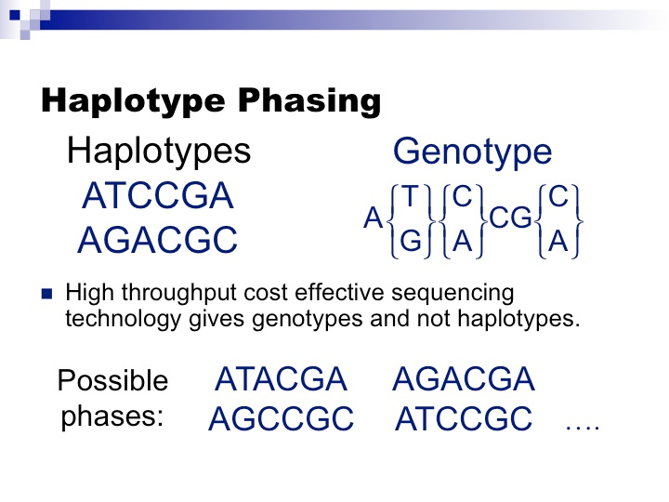

Slide 44
Three alleles (denoted by A₁, A₂ and A₃) were detected for the red cell acid phosphatase enzyme in a sample of 178 English people. All genotypes were distinguishable by electrophoresis and their frequencies in the sample were
Genotype A₁A₁ A₁A₂ A₁A₃ A₂A₂ A₂A₃ A₃A₃
Frequency (%) 9.6 48.3 2.8 34.3 5.0 0.0
What are the gene frequencies in the sample?
Data from Spencer et al. (Nature 201: 299-300, 1964).

Slide 45
Frequency of A₁ = (9.6*2+48.3+2.8)/100*178 = 125
Frequency of A₂ = (48.3+2*34.4+5.0)/100*178 = 217
Frequency of A₃ = (2.8+5.0+0.0*2)/100*178 = 14
Rate of A₁ (%) = 125/(2*178) = 35
Rate of A₂ (%) = 217/(2*178) = 61
Rate of A₃ (%) = 14/(2*178) = 4

Slide 46
As a candidate gene for human obesity, the β₁-adrenergic receptor (β₁AR) contains two common nonsynonymous polymorphism markers at codon 49 (Ser → Gly) and codon 389 (Arg → Gly).
To detect possible associations between these markers and obesity traits. To do so, however, we need to test if these markers are at Hardy-Weinberg equilibrium.
In a sample derived from a black woman population, nine genotypes (denoted by AABB, …, aabb) at codon 49 and codon 389 were observed as follows:
Codon 389 (B)
________________________________________________________________________
Codon 49 (A) Arg389Arg (BB) Arg389Gly (Bb) Gly389Gly (bb)
________________________________________________________________________
Ser49Ser (AA) 222 (32) 230 (33) 56 (8)
Ser49Gly (Aa) 106 (15) 65 (9) 0 (0)
Gly49Gly (aa) 13 (2) 0 (0) 0 (0)
________________________________________________________________________
Data listed are the observations (% in the parentheses)
According to your analysis, are these two markers at Hardy-Weinberg equilibrium in the sample studied?
Data from Wu et al. (Pharmacogenomics Journal, accepted, 2005).

Slide 47
The genotype frequencies of AA, Aa, aa are 508, 171, 13, respectively.
p_{A} = (508*2+171)/(2*692) =0.8577.
Expected numbers are 692*p_{A}² = 509, 692*2(1-p_{A})p_{A} =167, 692* (1-p_{A})² =14.
The chi-square statistic = sum(obs-exp)²/exp=0.1 < chi-square(0.05, df=1)=3.841.
The marker A is at Hardy-Weinberg equilibrium.
Similarly, The chi-square statistic for marker B = 0. 4956 < 3.841. The marker B is at Hardy-Weinberg equilibrium.

Slide 48
Calculate the coefficient of linkage disequilibrium (LD), D, between the two markers;
Calculate the normalized LD, D′;
Calculate the correlation, R, between the markers;
Test if these two markers are in linkage disequilibrium

Slide 49
Estimate pAB, pAb, paB, pab by EM algorithm at http://www.stat.ufl.edu/genetics/calc.htm. We have
pAB=0.5635838186071527; pAb=0.29407514093041953;
paB=0.14234103688417676; pab=3.578250980988104e-9;
D=pAB*pab-pAb*paB= -0.0419
pA=pAB+pAb= 0.8577, pB=pAB+paB= 0.7059; pa=1-pA= 0.1423; pb=1-pB= 0.2941;
D′=D/max(-pA*pB, -pa*pb)=1.
R=D/sqrt(pA*pa*pB*pb)= -0.2629.
Chi-square statistic = 2nD²/( pA*pa*pB*pb)= 95.6867. Two markers are in linkage disequilibrium.

Slide 50
Multipoint linkage mapping
Using 1000s of markers, genetic maps have been constructed across the whole genome
Multipoint mapping uses several markers at once to localise a disease gene relative to the other markers in the map
More efficient process than using one marker at a time

Slide 51
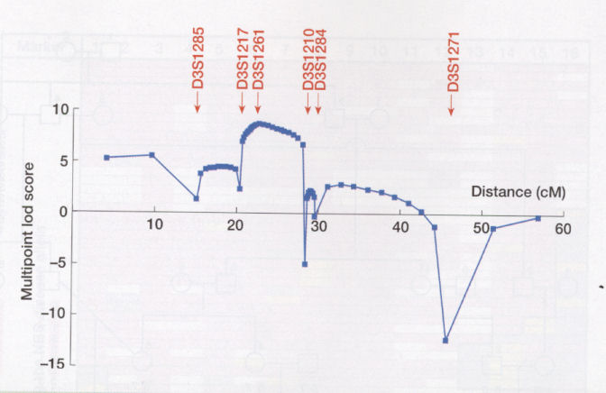
Multipoint mapping

Slide 52
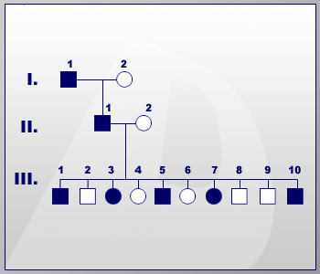
State the components of the genetic model.
Assign underlying disease genotypes given information in the genetic model.
Determine putative linkage phase.
Score the meiotic events as recombinant or non-recombinant.
Calculate and interpret lod scores.
Linkage Phase Known -Unlinked Marker
components of the genetic model include the inheritance pattern of the disease locus (autosomal or sex-linked; dominant, recessive, or codominant), disease allele frequency and penetrance, and the frequency of phenocopies and new mutation. In this example, the disease allele will be assumed to be rare and to function in an autosomal dominant fashion with complete penetrance, and the disease locus will be assumed to have two alleles: N (for normal or wild-type) and A (for affected or disease). In addition, mutation and phenocopies are assumed to be absent. These assumptions will allow substantial simplification of the problem.
Frequencies for the alleles at the marker locus are also required. In pedigrees in which genotypes are missing in founding individuals (due either to an unsampled individual or to laboratory complications), the misspecification of allele frequencies can have substantial impact, leading to incorrect conclusions of linkage and non-linkage and biased estimates of the recombination fraction.

Slide 53
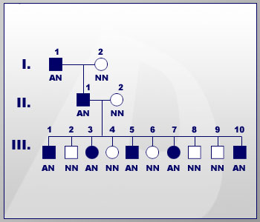
The relationship between genotype and phenotype as defined by the genetic model can be used to assign the underlying genotype of pedigree members at the disease locus. The assumption of complete penetrance of the disease allele allows all unaffected individuals in the pedigree to be assigned a disease genotype of NN. Since the disease allele is assumed rare, the disease genotype for affected individuals can be assigned as AN. In other words, since the disease allele is rare, the chance that an affected individual is homozygous for the disease allele is so small that, for the purposes of this example, it can be considered to be zero.

Slide 54
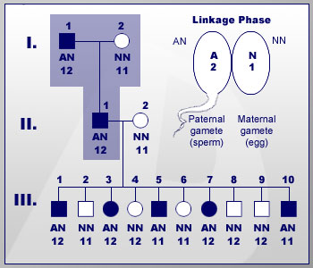
Now the putative linkage phase can be established. Individual II-1 has inherited the disease trait together with marker allele 2 from his affected father. Thus, the A allele at the disease locus and the 2 allele at the marker locus were inherited in the gamete transmitted to II-1.
Once the putative linkage phase (the disease allele "segregates" with marker allele 2) has been established, this phase can be tested in subsequent generations.
The null hypothesis is that the disease and marker loci are unlinked. If the loci are genetically unlinked, there will be an approximately equal number of recombinant and non-recombinant gametes among the offspring of II-1. The alternate hypothesis is that the disease and marker loci are linked. If the loci are genetically linked, there will be more non-recombinants than recombinants among the offspring (meiotic events) of II-1.

Slide 55
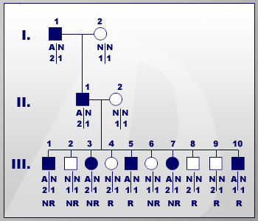
For this mating type, there are four possible gametes from the affected parent II-1: N1, N2, A1, and A2. Based on the putative linkage phase assigned in step 3, gametes A2 and N1 are non-recombinant. In other words, all affected offspring of II-1 and II-2 who have inherited marker allele 2 from their father will be scored as non-recombinant for the disease and marker; affected offspring who have inherited the 1 allele will be scored as recombinant for the disease and marker. Similar reasoning applies to the unaffected offspring, except that the unaffected offspring who have inherited allele 1 are non-recombinant and those who have inherited allele 2 are recombinant.
In this pedigree, five offspring of II-1 are recombinant and five are non-recombinant. Thus, out of ten scorable meiotic events, the number of recombinant gametes is equal to the number of non-recombinant gametes. These data are consistent with the hypothesis that the disease and marker loci are not linked.

Slide 56
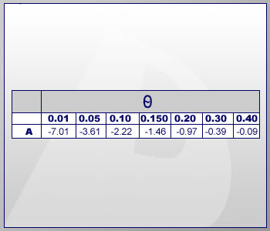
the highest lod score is -0.09 at = 0.40. At no value of is the lod score positive, let alone >3.0, so this pedigree demonstrates no evidence in favor of linkage between the disease and marker loci. However, all is not lost. The pedigree does provide important information about where the disease locus is NOT located. Visual inspection of the lod score data suggests that the value of at which the lod score is <2.0 is between 0.10 and 0.15, so approximately 13cM on either side of the marker locus can be excluded as harboring the disease gene -- a total exclusion of 26cM from typing this marker.

Slide 57
Linkage Phase Known : Linked Marker
State the components of the genetic model.
Rare disease allele
Autosomal dominant disease allele with complete penetrance
No mutation
No phenocopies

Slide 58
The assignment of disease genotypes to pedigree members is the same as in the previous example. Unaffected individuals have an underlying disease genotype of NN, and affected individuals have a disease genotype of AN.

Slide 59
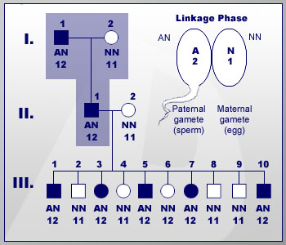
Genotypes are determined based on pedigree members. The assignment of putative linkage phase is identical to that in the previous example, so that the disease allele is transmitted in the same gamete as marker allele 2.

Slide 60
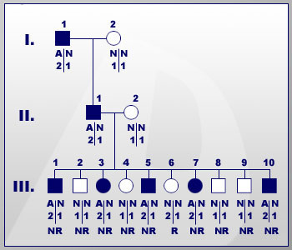
All five of the affected children have inherited marker allele 2 from their affected father and are thus non-recombinant. In addition, four of the five unaffected children have inherited marker allele 1 from their affected father. These four offspring, too, are non-recombinant with respect to the disease and marker loci. Individual III-6, however, is unaffected and has inherited marker allele 2 from his affected father. This individual is scored as a recombinant individual (a recombinant meiosis). This non-random segregation of the disease allele and a marker allele within a pedigree is consistent with linkage between the disease and marker locus.

Slide 61
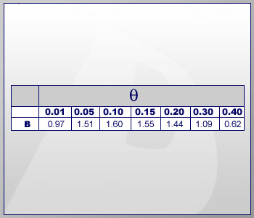
The lod scores for this pedigree at a variety of hypotheses about the recombination fraction between the disease and marker loci are shown here.
No lod score at any tested recombination fraction is higher than 3.0, so this pedigree does not provide significant evidence in favor of linkage between the disease and marker locus. The highest lod score in this pedigree is 1.6, which means more data from additional pedigrees need to be generated in order to interpret the results. However, this lod score is probably “interesting” enough that it would indeed warrant such follow-up. Here, it is critical to note that the recombination event occurs in an unaffected individual. If the assumption of complete penetrance of the disease allele is incorrect, the assignment of this meiotic event as a “recombinant” could be in error. Thus, it is incumbent on the investigator to weigh carefully information about disease gene localization gleaned from unaffected family members.

Slide 62
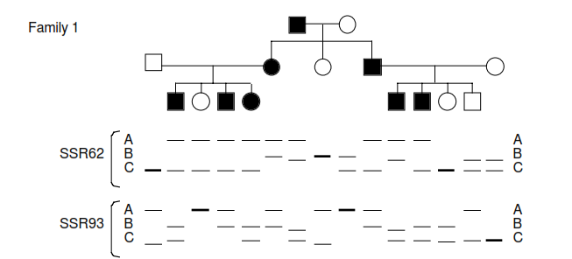
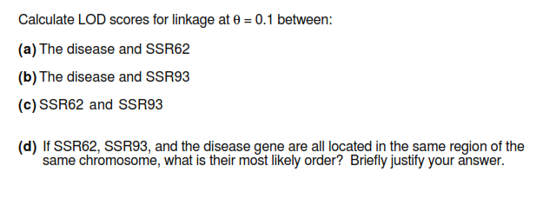
You are conducting genetic linkage studies of an autosomal dominant disease. You are focused on two SSR markers that may be linked to each other and to the disease. Here is a family in which some individuals are affected:

Slide 63



N R N N N N N N
Mother Father

